Slide 1

Secondary Research on Private Tutoring

Slide 2
Business Case
The goal of this analysis is to determine the market size of the global private tutoring industry based on information collected online such as,
Global Census data for the year 2017, which helped in determining the population carving out under different age bands.
Open source private tutoring market study articles available online from various market research and consulting agencies.

Slide 3
Overview
Global Private Tutoring Market
Academic Coaching
K-12
College
Test Prep
Admissions
Job Seekers

Slide 4
Primary Research

Slide 5
Primary Research
The data gathering phase, where the data required and relevant to the analysis is documented using Excel.
The excel sheet now has information related to k-12 private tutoring market, Test Preparation market viz-a-viz admissions for P.G & Job seekers(overseas).
Based on the data gathered suitable visualisations are done using Tableau to help understand the insights better,

Slide 6
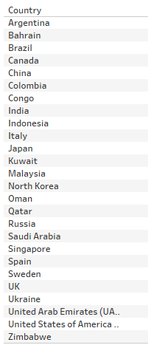
Countries analyzed
26 countries are studied for this analysis.
The countries are picked in such a way that it covers locations where there is a demand for private tutoring services and the demand is growing consistently over the years.

Slide 7
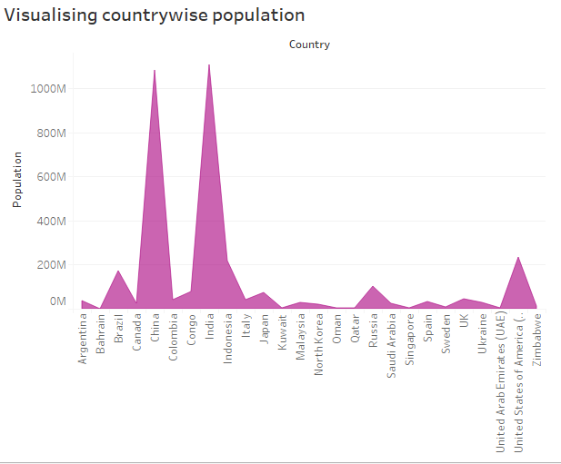
Worldwide Population
Plot shows contrywise population. Among the 26 countries analysed ,China and India have topped the charts.

Slide 8
Market Size Estimation of K-12 private tutoring market

Slide 9
Market Size Estimation
The business case is to study private tutoring markets on various location’s, population data is vital to perform this analysis.
Reliable data source for this analysis would be census data consisting demographic information of various locations worldwide. Following government data source is accessed to collect information relevant to this study.
https://www.cia.gov/library/publications/the-world-factbook/geos/in.html

Slide 10
Market Size Estimation – Primary Education
Private tutors for primary school kids starting from age 7-14 is estimated by carving out 50% of the population from the original population where the age range was from 0 -14.

Slide 11
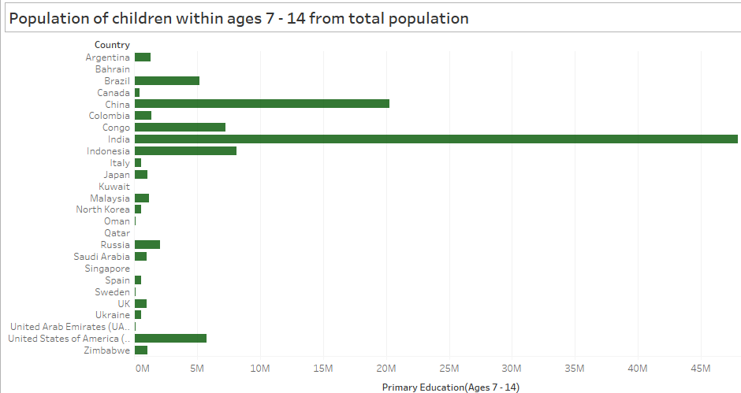
Worldwide Population of age group(7-14)
From the visual India & China tops population with age group 7- 14

Slide 12
Market Size Estimation – Secondary School
For estimating secondary school kids enrolling themselves to private tutoring classes, we have considered 30% of the original population which had age range of 15-24.

Slide 13
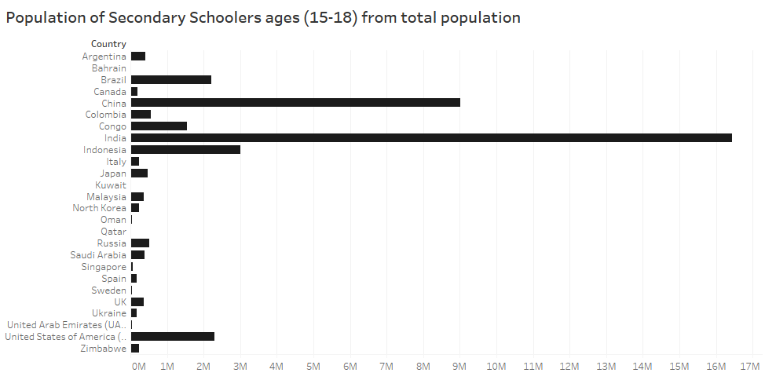
Population of children under 18

Slide 14
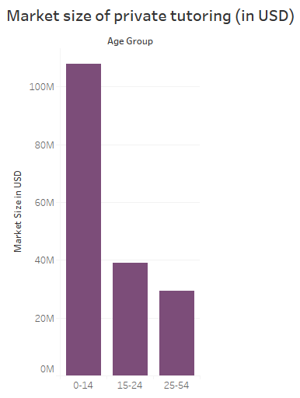
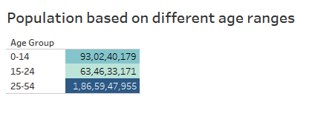
Age Groups
From the original population data available, one can split to different age buckets and tag them as primary , secondary, higher education.
Based on the derived figures we would be able to calculate the market size.

Slide 15
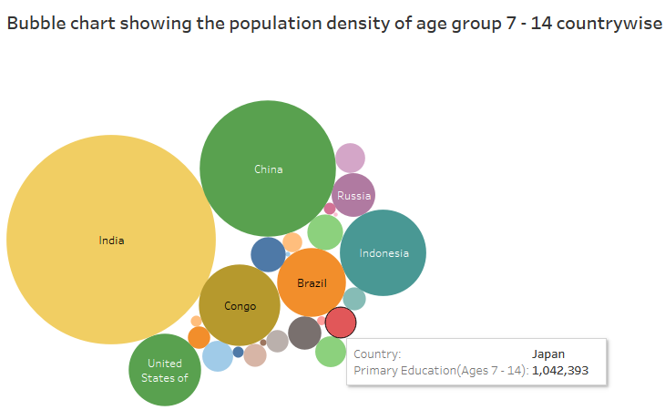
Bubble Chart for population density

Slide 16
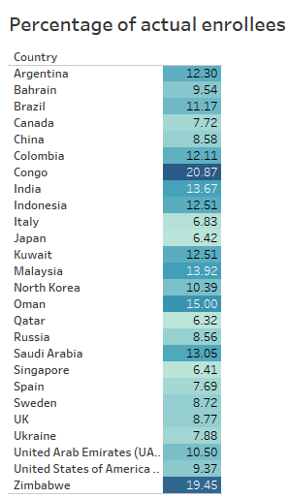
Percentage of actual enrollees
Heat Map view shows percentage of actual enrollees from the original population of age range 1-14 & 15-25.
Percentage of enrollees in Congo and Zimbabwe are higher compared to India and China.
Few countries where the enrollment size is less than 7% are Italy, Japan & Singapore.
The estimates here are
Overall population % of age group(0-14)*50/100.That is nothing but 50% of the population belonging to age range 0-14.

Slide 17
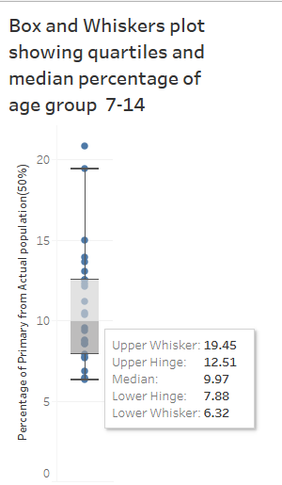
Box and Whiskers plot
Plot shows minimum , max and median of percentages of people within the age bucket of 7-14 worldwide
9% (approx) of the population is of the age range 7-14 from the original data having age range of 0-14.

Slide 18
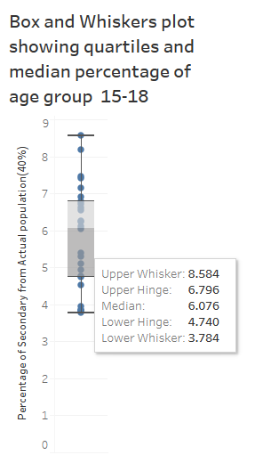
Plot shows min,max and median of percentages of people within the age bucket of 15-18 worldwide from the overall population.
6% (Approx) of the population is of the age range 15-18. from the original data having age range of 15-24.

Slide 19
K-12 Market Size
K-12 Private tutoring market estimate is derived using the formula (Total Primary School Enrollments*50)/100+(Total Secondary School Enrollments*60)/100.
The formulation is done based on the fact that in most of the countries, in order to score better and to have good educational progress students enroll for tutoring services, particularly during their high schooling.

Slide 20
Test Preparation Market

Slide 21
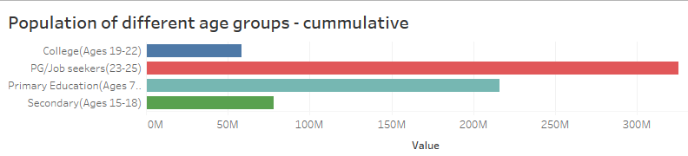
Age Groups
The figure below represents the derived attributes from the original data like numbers relating to Primary(ages 7-14),Secondary(15-18),College enrollees(19-22),Test Prep(>22).

Slide 22
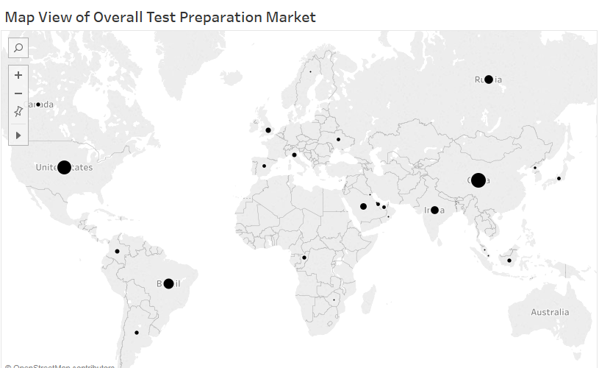
Global view of the Test Preparation Market

Slide 23
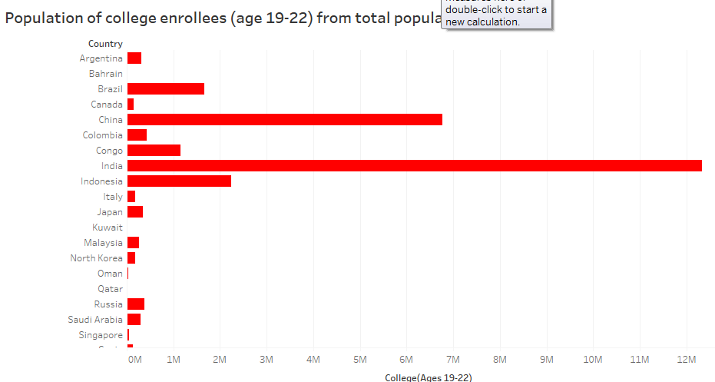
Population of college students

Slide 24
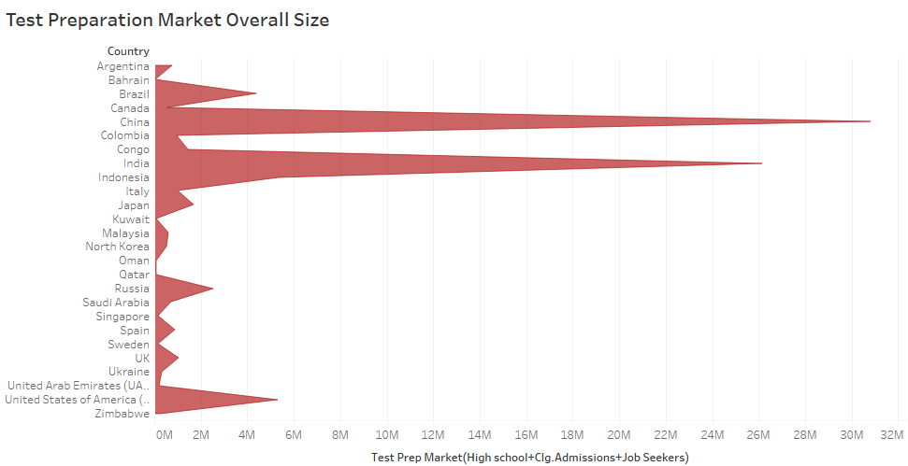
Line Chart Displaying Test Prep Market
India and China are the highest contributor to Test Preparation Market.

Slide 25
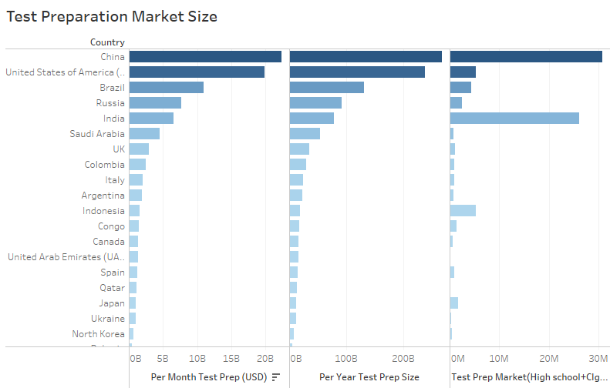
Overview -Test Preparation Market
The bar chart shows the overall test prep market in terms of Number of enrollees,turn over per year & month on different locations.

Slide 26
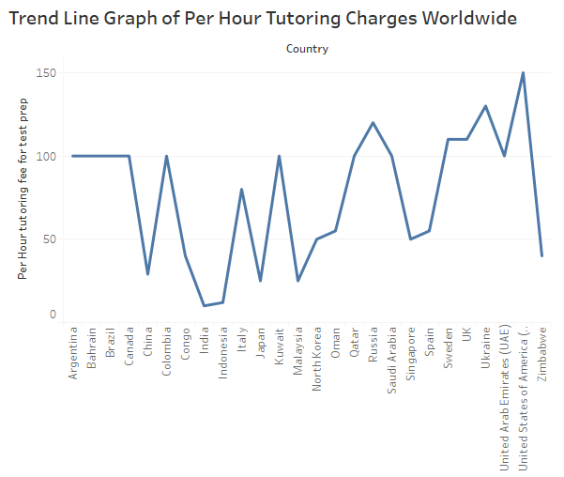
Tutoring Charges Per Hour
In order to derive the overall market size,we have estimated per hour tutoring charges for test preparation in different locations and the same is shown in the plot below.

Slide 27
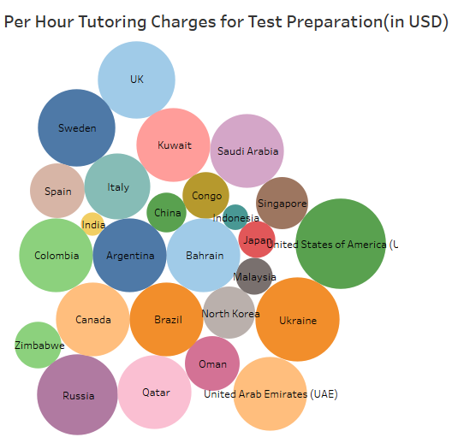
Per Hour Charges - Density
Bubble chart view of per hour private tutor charges for test preparation shows that countries like Saudi ,Bahrain, Qatar,USA & UAE have higher rates compared to all other countries.
Rates are estimated using data available in online forums.
Typically tutor rates range from anywhere between $10 - $150,depeding on the course one enrolls into and also the charges depend on the expertise of the tutor.

Slide 28
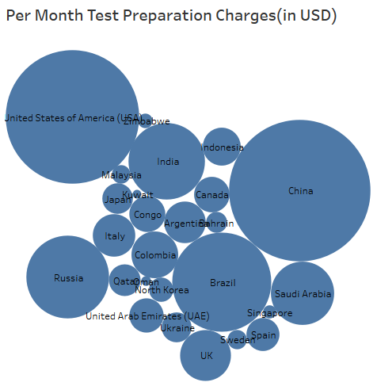
Plot shows per month test preparation size.
USA , China, Brazil,India and Russia have higher turnover per month compared to other countries.

Slide 29
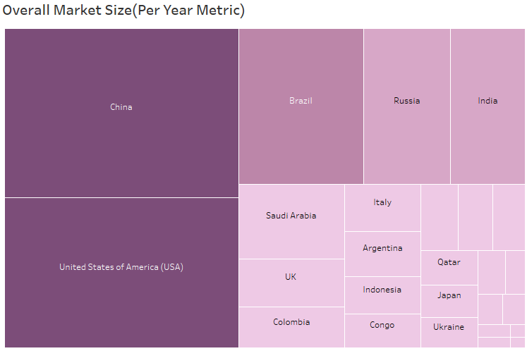
Overall Market Size of Test Preparation
Market Size for Test Preparation has higher scope in countries like China, USA, Brazil, Russia and India.

Slide 30
Test Preparation Market
Test Preparation Market metrics are analysed, from the data gathered using Census on student population.
The formulation here is that approximately 40% of the population in the age range(15-18),30% of the population in the age range(19-22),20% of the population in the age range (23-25) enroll themselves for test preparation tutoring services.

Slide 31
Competitor Analysis

Slide 32
We have gathered information about private tutoring agencies functioning in different countries studied and visualized the same using Tableau.

Slide 33
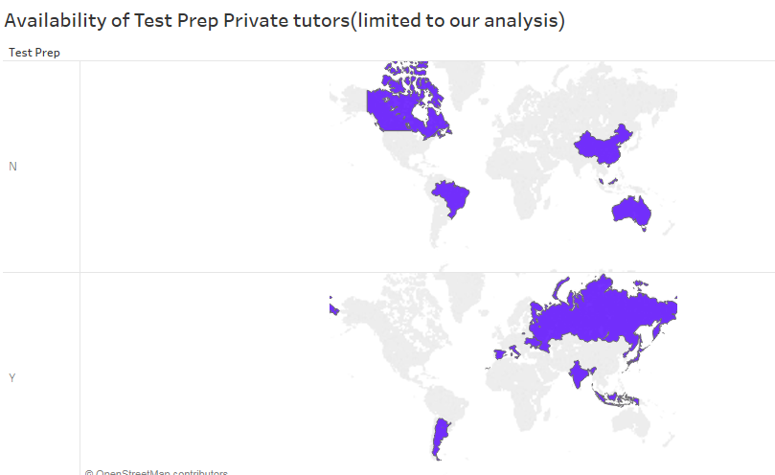
Test Preparation Private Tutoring

Slide 34
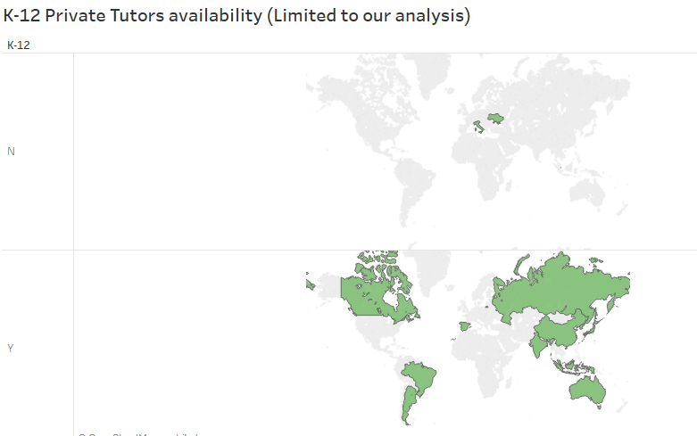
K-12 Private Tutoring

Slide 35
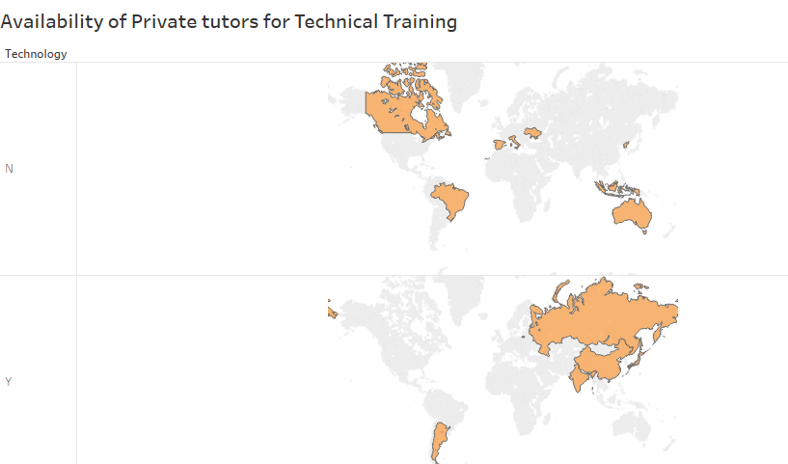
Private Tutors for Technical Learning

Slide 36
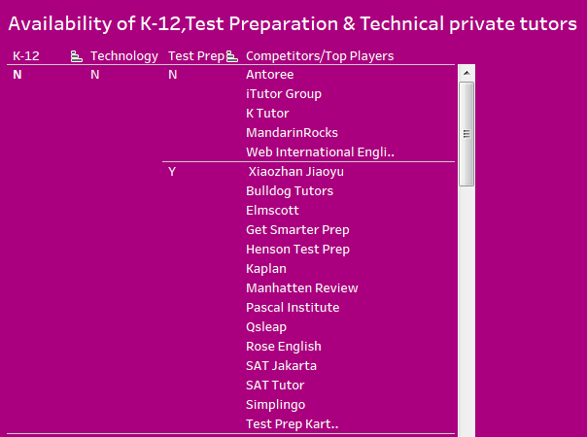
Summary Visual
This visual summarises data based on whether k-12,Test Prep or Technology private tutors availability on a tutoring site.

Slide 37
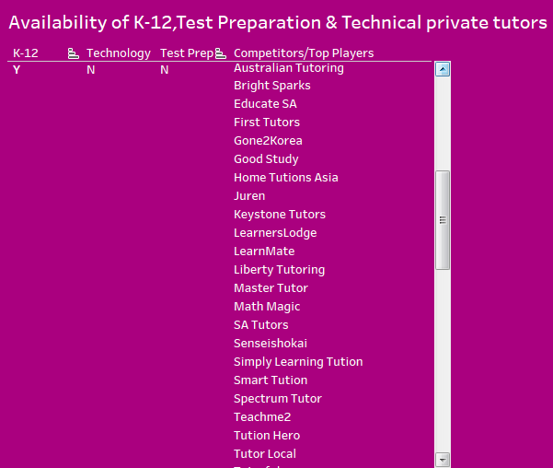
The visual adjacent shows availability of K-12 private tutors.

Slide 38
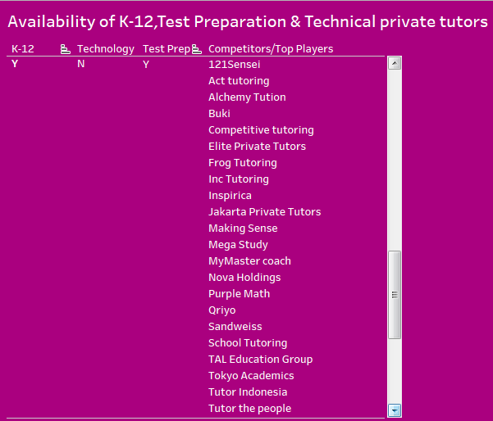
This visual shows tutoring organizations' offering both K-12 & Test Prep services.

Slide 39
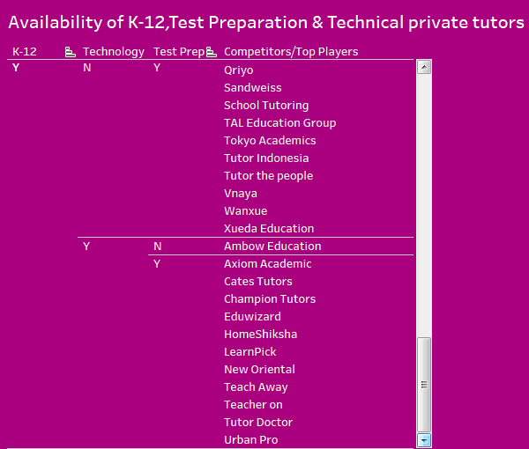
This visual shows all other possible combinations which were not covered in previous slides.

